Slide 1
WEEK 23
How the neural policy and its training pipeline work
Cesar A. Pascal Vasquez
Week 23 | 1
Notes:
[Sources]
- /Users/cesarpascal/Desktop/week 23 research/README.md
- /Users/cesarpascal/Desktop/week 23 research/results/training_summary.json
[/Sources]

Slide 2
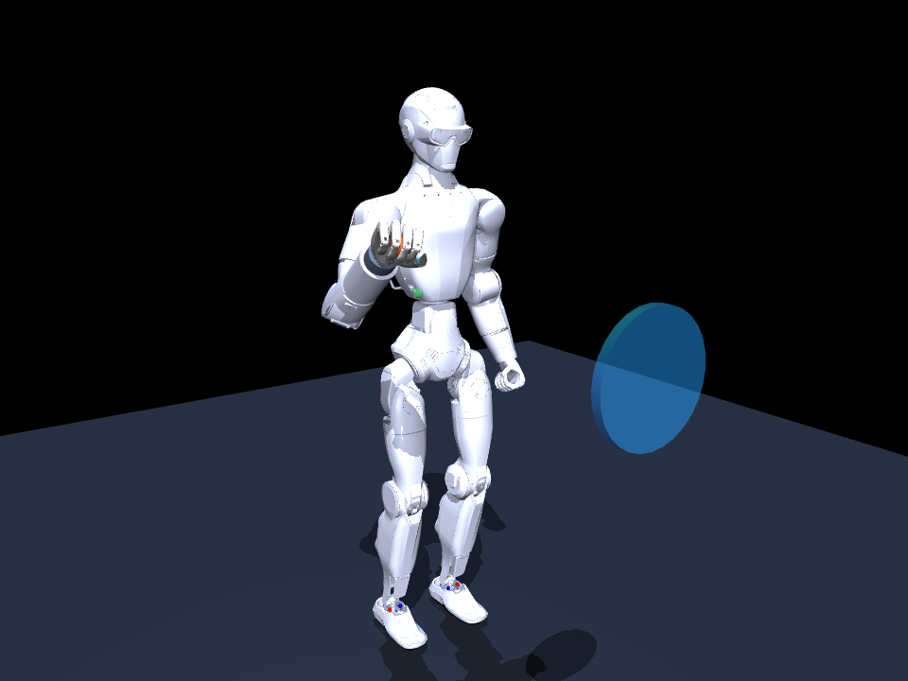
The controller coordinates 11 actuators on the R1.
Five right-arm joints position the wrist; six Revo 2 joints form the grasp. Every other robot joint stays in the standing pose.
Actions are normalized to –1…+1, then converted to joint targets inside MuJoCo at 40 Hz.
R1 + Revo 2 manipulation model
Week 23 | 2
Notes:
[Sources]
- /Users/cesarpascal/Desktop/week 23 research/model/r1_revo2_reach_throw.xml
- /Users/cesarpascal/Desktop/week 23 research/scripts/r1_revo2_env.py
- https://www.brainco-hz.com/docs/revolimb-hand/en/revo2/parameters.html
- https://github.com/unitreerobotics/unitree_mujoco
[/Sources]

Slide 3
The task builds a stable grasp before the throw.
1
Reach with an open hand (0.00–1.45 s).
2
Enable contact, close the fingers, and secure the ball.
3
Release the fixture, then lift and wind up (2.90–3.80 s).
4
Open the hand and finish the throw (3.88–4.30 s).
5.30-s episode | 40 Hz control | six task phases
Week 23 | 3
Notes:
[Sources]
- /Users/cesarpascal/Desktop/week 23 research/scripts/r1_revo2_env.py
[/Sources]

Slide 4
Each step uses 51 normalized observations.
TASK (13)
MEMORY (11)
Time + phase: 7
Ball–palm error: 3
Target–ball error: 3
Previous 11 commands
reveal delay and
action history
ROBOT STATE (27)
Palm + ball motion: 9
Arm state: 10
Hand + contacts: 8
13 TASK + 27 ROBOT + 11 MEMORY = 51 OBSERVATIONS
Week 23 | 4
Notes:
[Sources]
- /Users/cesarpascal/Desktop/week 23 research/scripts/r1_revo2_env.py
[/Sources]

Slide 5
The network learns corrections around a safe motion.
INPUT
RESIDUAL
51 normalized observations
Mean/std from teacher data
Clipped noisy state
Arm correction: ±0.25
Hand correction: ±0.08
Final command clipped
–1 to +1
TWO-LAYER MLP
128 tanh units per layer
11 tanh outputs
NOMINAL ACTION + SCALED NETWORK OUTPUT → FINAL ACTION
Week 23 | 5
Notes:
[Sources]
- /Users/cesarpascal/Desktop/week 23 research/scripts/neural_policy.py
- /Users/cesarpascal/Desktop/week 23 research/results/training_summary.json
[/Sources]

Slide 6
A nominal trajectory provides the basic motion.
Five arm waypoints—home, reach, lift, windup, and throw—are blended with smoothstep timing.
The hand closes from 1.37 to 3.88 s, then opens over 0.10 s. The network adjusts this plan instead of replacing it.
Nominal windup before the learned correction
Week 23 | 6
Notes:
[Sources]
- /Users/cesarpascal/Desktop/week 23 research/scripts/neural_policy.py
- /Users/cesarpascal/Desktop/week 23 research/media/policy_windup.png
[/Sources]

Slide 7
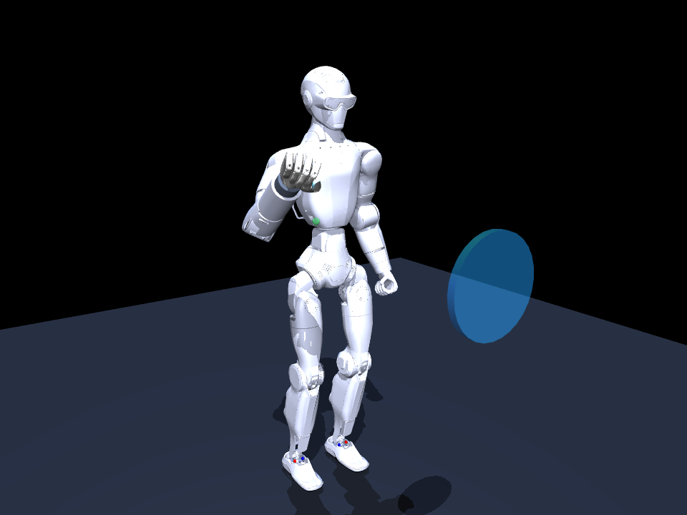
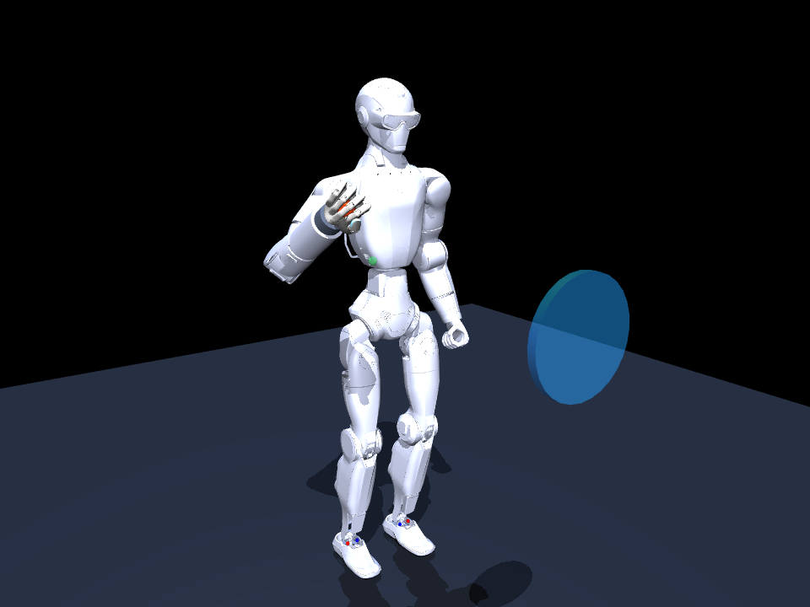
Before training, the network loses the ball.
0%
success on this episode
35.0 mm
mean minimum reach error
reached | no grasp | no hold
ball dropped at 3.42 s
Week 23 | 7
Notes:
[Sources]
- /Users/cesarpascal/Documents/Training/week 23 research/scripts/render_policy.py
- /Users/cesarpascal/Documents/Training/week 23 research/scripts/neural_policy.py
- /Users/cesarpascal/Documents/Training/week 23 research/results/untrained_demo_metrics.json
- /Users/cesarpascal/Documents/Training/week 23 research/media/untrained_policy_demo.mp4
[/Sources]

Slide 8
The teacher is a scripted expert, not a trained network.
1
Read the exact randomized ball and target positions.
2
Use damped-least-squares IK to solve four arm waypoints.
3
Interpolate the waypoints and apply a timed power grasp.
4
Return the 11 ideal commands used as training labels.
Teacher success: 88.3% over 240 randomized demonstrations
Week 23 | 8
Notes:
[Sources]
- /Users/cesarpascal/Desktop/week 23 research/scripts/r1_revo2_env.py
- /Users/cesarpascal/Desktop/week 23 research/results/training_summary.json
[/Sources]

Slide 9
The scripted teacher completes every task phase.
100%
success on this episode
14.9 mm
mean minimum reach error
grasp | hold | release | throw
0.21 m forward distance
Week 23 | 9
Notes:
[Sources]
- /Users/cesarpascal/Documents/Training/week 23 research/scripts/render_policy.py
- /Users/cesarpascal/Documents/Training/week 23 research/scripts/r1_revo2_env.py
- /Users/cesarpascal/Documents/Training/week 23 research/results/teacher_demo_metrics.json
- /Users/cesarpascal/Documents/Training/week 23 research/media/teacher_policy_demo.mp4
[/Sources]

Slide 10
Teacher rollouts seed the imitation dataset.
1
Run 240 randomized episodes beginning at seed 23,000.
2
Store each 51-value state with its teacher action.
3
Balance batches equally across the six task phases.
4
Run 2,400 Adam updates before DAgger begins.
Initial data + two DAgger rounds = 63,985 labeled samples
Week 23 | 10
Notes:
[Sources]
- /Users/cesarpascal/Desktop/week 23 research/scripts/train_policy.py
- /Users/cesarpascal/Desktop/week 23 research/results/training_summary.json
[/Sources]

Slide 11
Behavioral cloning copies the teacher’s corrections.
TARGET
EMPHASIS
Teacher action
minus nominal action
scaled and clipped
Arm outputs: 4.0
Hand outputs: 1.5
Gradients clipped:
–2 to +2
OBJECTIVE
Weighted MSE + decay
Adam, batch size 512
TEACHER TARGETS → BACKPROPAGATION → UPDATED WEIGHTS
Week 23 | 11
Notes:
[Sources]
- /Users/cesarpascal/Desktop/week 23 research/scripts/train_policy.py
- /Users/cesarpascal/Desktop/week 23 research/scripts/neural_policy.py
[/Sources]

Slide 12
DAgger adds recovery examples from visited states.
1
Run mixed teacher/network behavior for 60 episodes.
2
Ask the teacher to label every state the mixture visits.
3
Append the new states and labels to the dataset.
4
Retrain 1,200 steps, then repeat for a second round.
Teacher execution probability falls from 45% to 15%
Week 23 | 12
Notes:
[Sources]
- /Users/cesarpascal/Desktop/week 23 research/scripts/train_policy.py
- https://proceedings.mlr.press/v15/ross11a.html
[/Sources]

Slide 13
Domain randomization reduces sensitivity to one setup.
• Object: start and target positions, radius 16.5–19.5 mm, mass 38–70 g, and friction 0.75–1.45.
• Robot: actuator gains 82–118% and command delay of 0–2 frames.
• Sensing: noisy observations plus varied IK seeds and waypoints.
The same randomization is active during 100 held-out evaluation episodes.
Week 23 | 13
Notes:
[Sources]
- /Users/cesarpascal/Desktop/week 23 research/scripts/r1_revo2_env.py
[/Sources]

Slide 14
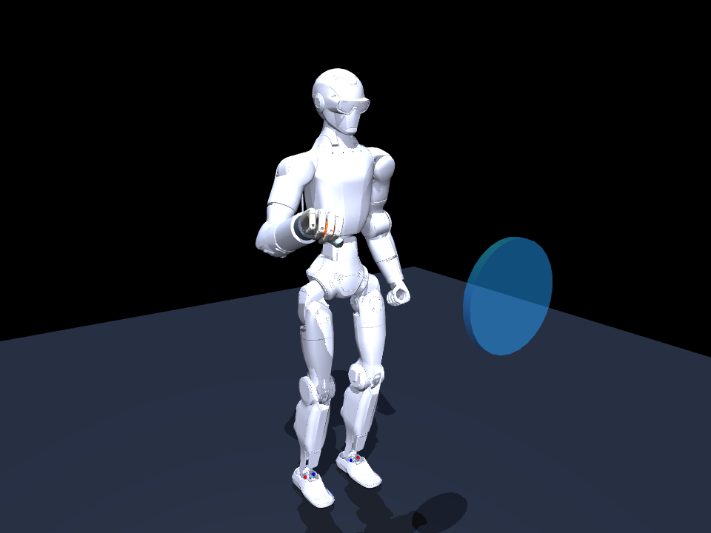
After training, the policy succeeds in 81% of trials.
81%
complete task success
13.4 mm
mean minimum reach error
97% grasp | 88% hold/release
0.20 m mean throw
Week 23 | 14
Notes:
[Sources]
- /Users/cesarpascal/Documents/Training/week 23 research/results/final_policy_evaluation.json
- /Users/cesarpascal/Documents/Training/week 23 research/media/policy_grasp.png
- /Users/cesarpascal/Documents/Training/week 23 research/media/neural_policy_demo.mp4
[/Sources]

Slide 15
References
BrainCo. (n.d.). Revo 2 parameters. https://www.brainco-hz.com/docs/revolimb-hand/en/revo2/parameters.html
BrainCo. (n.d.). Revo 2 download center. https://www.brainco-hz.com/docs/revolimb-hand-dev/en/revo2/download.html
DeepMind. (2026). MuJoCo XML reference (Version 3.6). https://mujoco.readthedocs.io/en/3.6.0/XMLreference.html
Unitree Robotics. (2026). unitree_mujoco [Computer software]. https://github.com/unitreerobotics/unitree_mujoco
Unitree Robotics. (2026). unitree_rl_mjlab [Computer software]. https://github.com/unitreerobotics/unitree_rl_mjlab
Ross, S., Gordon, G. J., & Bagnell, J. A. (2011). A reduction of imitation learning and structured prediction to no-regret online learning. AISTATS, 15, 627–635. https://proceedings.mlr.press/v15/ross11a.html
Week 23 | 15
Notes:
[Sources]
- https://www.brainco-hz.com/docs/revolimb-hand/en/revo2/parameters.html
- https://www.brainco-hz.com/docs/revolimb-hand-dev/en/revo2/download.html
- https://mujoco.readthedocs.io/en/3.6.0/XMLreference.html
- https://github.com/unitreerobotics/unitree_mujoco
- https://github.com/unitreerobotics/unitree_rl_mjlab
- https://proceedings.mlr.press/v15/ross11a.html
[/Sources]

